Slide 1



PYTHON PROGRAMMING COURSE
Introduction to Object-Oriented
Programming (OOP) in Python
Understanding Encapsulation
PRESENTED BY
DATE OF SESSION
Muhammad Yousif Memon
June 2026

Slide 2

Learning Objectives
Understand Object-Oriented Programming
Differentiate Procedural and OOP programming
Explain Classes and Objects
Understand OOP principles
Learn Encapsulation
Apply Encapsulation in Python programs
Object-Oriented Programming in Python | Encapsulation

Slide 3
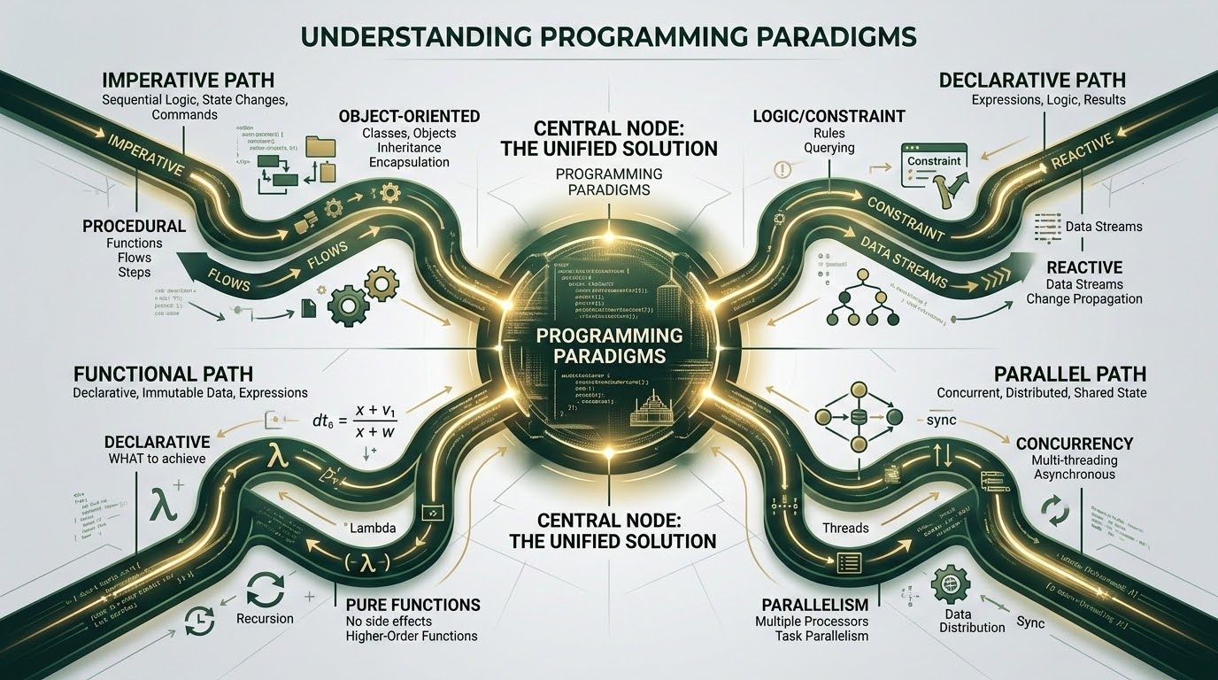
What is Programming Paradigm?
A programming paradigm is a style or method of writing programs.
COMMON PARADIGMS
Procedural Programming
Object-Oriented Programming (OOP)
Functional Programming
Event-Driven Programming
Python Flexibility: Supports multiple programming paradigms, making it highly flexible.
Python Development Essentials | Programming Paradigms

Slide 4

What is Object-Oriented Programming (OOP)?
Programming methodology where programs are designed using objects instead of only functions.
CORE CHARACTERISTICS
Object Composition: An object combines Data (Attributes) and Functions (Methods).
Real-World Modeling: OOP models real-world entities and their behaviors.
Object-Oriented Programming in Python | Introduction

Slide 5
Why Do We Need OOP?
How software complexity scales and how Object-Oriented Programming solves it.
THE PROBLEM
THE SOLUTION
Scaling Issues in Procedural Code
Object-Oriented Solutions
As software grows, maintaining and expanding a procedural codebase becomes increasingly complex:
OOP introduces powerful design paradigms that model real-world concepts to resolve scaling limitations:
Maintenance: Code is hard to maintain.
Organization: Better organization.
Repetition: Repetition increases.
Reusability: Code reusability.
Debugging: Debugging is difficult.
Maintenance: Easy maintenance.
Collaboration: Collaboration is harder.
Modularity: Modularity.
Object-Oriented Programming in Python | OOP Fundamentals

Slide 6
Real-Life Examples of Objects
CAR OBJECT
STUDENT OBJECT
BANK ACCOUNT OBJECT
ATTRIBUTES Color, Model
METHODS Start(), Stop()
ATTRIBUTES Name, Roll No
METHODS Study(), AttendClass()
ATTRIBUTES Balance
METHODS Deposit(), Withdraw()
CORE IDEA & EXAMPLES
Everything around us can be viewed as an object.
Mobile: Attributes (Brand, Storage) | Methods (Call(), Charge())
Python Development Essentials | Real-Life Examples of Objects

Slide 7
Procedural Programming vs OOP
Comparing Programming Paradigms in Python
Procedural Paradigm: Focuses on functions
Object-Oriented Paradigm: Focuses on objects
Separated Data: Functions operate on external data, creating a clean separation that can lead to unintended structural side effects.
Encapsulated State: Bundles state data (attributes) and behavior (methods) cleanly together, preventing unauthorized direct changes.
Harder to Scale: As project size increases, managing global state values and tracing bug origins becomes highly complex.
Highly Scalable: Modular structure enables engineering teams to easily maintain, debug, and expand large software architectures.
Linear Logic: Execution runs top-down through sequential blocks, limiting the ease of reusing standalone utilities.
Intuitive Modeling: Uses real-world metaphors with inheritance and polymorphism to simplify design logic and accelerate development.
Python Development Essentials | Package Management & File Handling

Slide 8
Basic Concepts of OOP
MAIN CONCEPTS
ADVANCED CONCEPTS
Class
Encapsulation
Object
Inheritance
Attributes
Polymorphism
Methods
Abstraction
Python Development Essentials | Object-Oriented Programming

Slide 9
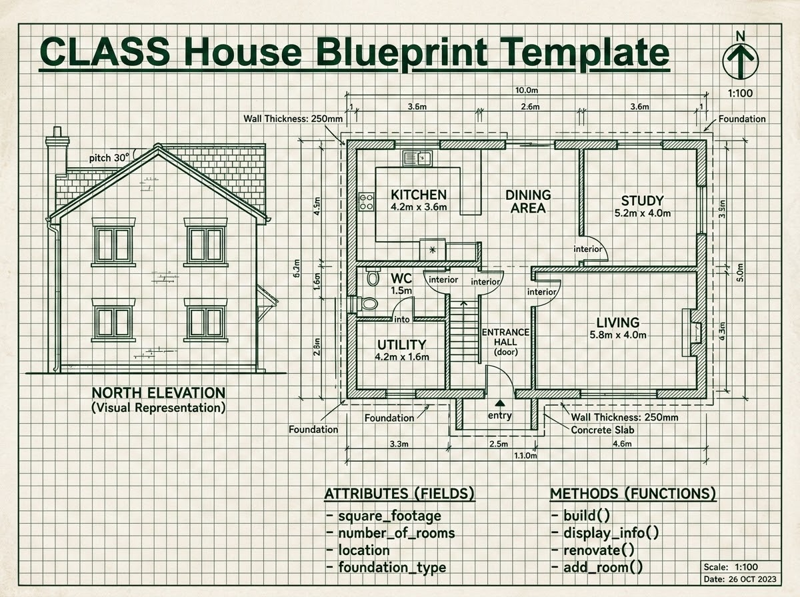
What is a Class?
A Class is a template or blueprint used to create individual objects. It serves as the master design in object-oriented programming.
CORE COMPONENTS
Data (Attributes): The state, properties, or variables defined for the class.
Behaviors (Methods): The functions or actions that objects of the class can execute.
PRACTICAL METAPHOR
Example: A Student class defines what fields (such as name or GPA) and actions (such as study or register) every individual student object will have.
Class Blueprint Metaphor
Object-Oriented Programming in Python | Classes & Objects

Slide 10

What is an Object?
Core Concept
Definition
An Object is an instance of a class.
Structure
Each object has its own values but follows the same structure.
Example Relationship
Class Student
Objects Ali, Ahmed, Sara
Visual Metaphor: Class Blueprint to House Instances
Object-Oriented Programming in Python | Objects & Classes

Slide 11
Creating a Class in Python
PYTHON CODE EXAMPLE
class Student:
pass
class
Student
pass
keyword creates a class.
is the class name.
means the class is currently empty.
Object-Oriented Programming in Python | Encapsulation

Slide 12
Creating Objects
CODE SNIPPET
EXPLANATION
class Student:
pass
std1 = Student()
std2 = Student()
Instantiation in Memory
Distinct Instances
Two separate objects are created. Both belong to the Student class blueprint, but they exist independently in memory.
Independent States
Modifying attributes or variables within std1 does not affect the state of std2.
Object-Oriented Programming in Python | Encapsulation

Slide 13
Constructor (init)
The constructor initializes object data automatically.
EXAMPLE CODE
class Student:
def __init__(self, name):
self.name = name
KEY TAKEAWAY
Whenever an object is created, __init__() executes automatically.
Object-Oriented Programming in Python | Encapsulation

Slide 14
Understanding `self`
Definition: self refers to the current object instance.
CONSTRUCTOR CODE EXAMPLE
ROLE OF THE SELF PARAMETER
Active Instance Reference: Points directly to the specific class instance currently being initialized or manipulated.
class Student:
def __init__(self, name):
self.name = name
# self binds the name attribute to the active object
State Isolation: Binds variables to the class instance, ensuring that data does not bleed across different instances.
Automatic Passing: Passed implicitly by Python behind the scenes as the first argument whenever any instance method is called.
INDIVIDUAL STATE OWNERSHIP
Here, self.name belongs to each object individually.
This guarantees that different Student objects can maintain their own independent name values simultaneously without collision.
Explicit Syntax: Required in method signatures but not when calling the methods from instantiated object scopes.
Object-Oriented Programming in Python | Encapsulation

Slide 15
Example of Class and Object
Implementing a basic class, instantiating an object, and invoking its methods in Python.
PYTHON CODE EXAMPLE
class Student:
def __init__(self, name):
self.name = name
def display(self):
print(self.name)
s1 = Student("Ali")
s1.display()
EXPECTED OUTPUT
Ali
Object-Oriented Programming in Python | Classes and Objects

Slide 16
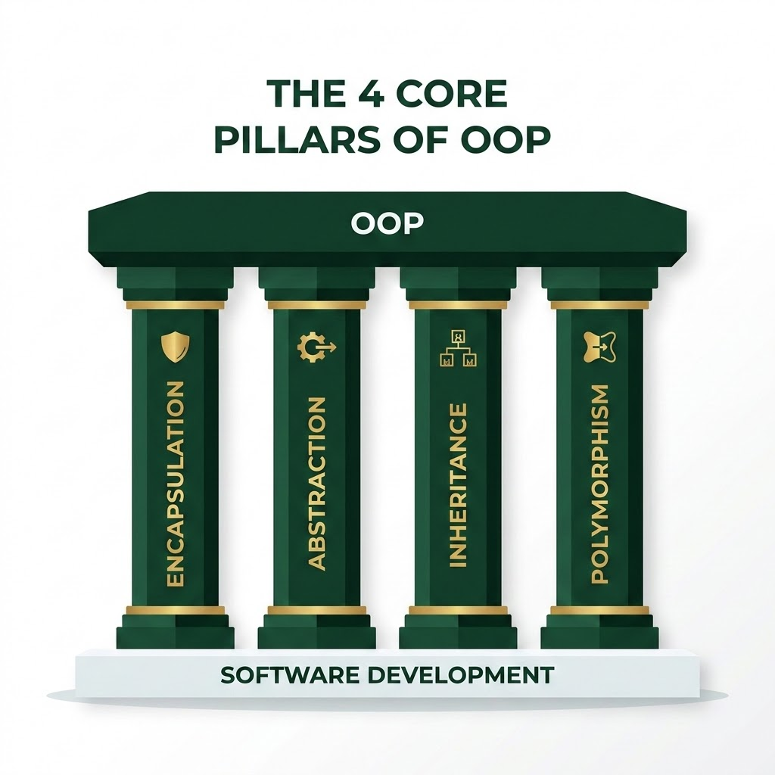
Four Pillars of OOP
Primary Focus Today
01. Encapsulation
02
Inheritance
03
Polymorphism
04
Abstraction
Object-Oriented Programming in Python | Encapsulation

Slide 17

What is Encapsulation?
Wrapping data and methods into a single unit (Class) and controlling direct access to that data.
CONCEPT METAPHOR
class Capsule(Variables + Methods)
PURPOSE
Protects the internal state of an object by restricting direct external modification.
Conceptual representation of data and logic encapsulated within a class capsule.
Object-Oriented Programming in Python | Encapsulation

Slide 18



Why Encapsulation?
CORE BENEFITS
CONCEPT VISUALIZATION
Protects sensitive information
Public Interface
Controlled Access
Prevents accidental changes
Improves security
Makes code easier to maintain
Private State
Hidden & Secured
Provides controlled access
Object-Oriented Programming in Python | Encapsulation

Slide 19
Access Modifiers in Python
Convention: Python relies on explicit naming conventions to signal member visibility and access levels.
PUBLIC
PROTECTED
PRIVATE
Accessible from anywhere, both inside and outside the class.
No prefix notation.
Accessible within the class and its subclasses.
Single underscore prefix.
Accessible only within the defining class.
Double underscore prefix.
self.variable
self._variable
self.__variable
Crucial Note
Python does not enforce strict access modifiers like Java or C++. All attributes remain technically public; naming conventions serve as a strong visual contract and developer guideline to respect encapsulation.
Python Development Essentials | Object-Oriented Programming

Slide 20
Public Members
PYTHON CODE
CONCEPT DEFINITION
class Student:
def __init__(self):
self.name = "Ali"
s = Student()
print(s.name)
Public variables are accessible from anywhere.
Unrestricted Access: Public attributes can be accessed directly from both inside the class methods and outside of the class.
Dot Notation: External scopes can read and write the values of public variables directly using the instance name dot attribute operator.
CONSOLE OUTPUT
Default Behavior: In Python, all class members and attributes are public by default unless explicitly configured otherwise.
Ali
KEY TAKEAWAY
Public attributes allow simple, direct access which is useful for basic data storage, but they do not provide built-in data validation or protection mechanisms.
Object-Oriented Programming in Python | Encapsulation

Slide 21
Protected Members
Definition: Protected members start with a single underscore.
class Student:
def __init__(self):
self._name = "Ali"
# Accessing protected attribute
s = Student()
print(s._name) # Prints: Ali
INTENDED USE
Protected members are primarily intended for internal class operations and access within subclasses.
While technically accessible from outside, doing so violates OOP design principles and encapsulation guidelines.
BEHAVIOR & SAFETY
The single underscore acts as a visual warning to other developers, requesting them not to modify or access the member.
It signals developer restraint rather than enforcing physical safety; Python will not raise an error if accessed directly.
Object-Oriented Programming in Python | Encapsulation

Slide 22
Private Members
Private members start with double underscores to restrict direct external access.
PYTHON CODE
ACCESS RESTRICTION
Direct Access Prohibited: Attempting to reference a private attribute from outside class methods triggers an immediate error.
Name Mangling: Python internally alters private variable identifiers to prevent accidental modification or namespace pollution.
class Student:
def __init__(self):
self.__name = "Ali" # Private attribute
s = Student()
print(s.__name) # Direct access attempt
Console Output (Execution Error)
AttributeError: 'Student' object has no attribute '__name'
Result: The program safely terminates to prevent direct private variable exposure.
Object-Oriented Programming in Python | Encapsulation & Private Members

Slide 23
Accessing Private Variables using Methods
CODE IMPLEMENTATION
CONTROLLED ACCESS CONCEPT
class Student:
def __init__(self):
self.__name = "Ali" # Private variable
def get_name(self):
return self.__name # Getter method
s = Student()
print(s.get_name())
REGULATING VISIBILITY
Getter and Setter methods act as secure, structured pathways to interact with private class attributes.
No Direct Access: Direct external reads (like s.__name) are restricted and will raise an AttributeError.
Read-Only Safety: The helper method get_name() provides safe read-only retrieval without exposing internal code design.
Encapsulation: Shielding private properties simplifies API debugging and maintains clean object boundaries.
CONSOLE OUTPUT
Ali
Object-Oriented Programming in Python | Encapsulation

Slide 24
Advantages of Encapsulation
DATA SECURITY
MODULARITY
SYSTEM STABILITY
Data Hiding: Ensures crucial information remains protected through restricted direct access and better security.
Controlled Access: Exposes only safe, authorized interfaces to external classes for improved modularity.
Easier Debugging: Guarantees better code maintenance, isolated system faults, and increased reliability.
KEY TAKEAWAY
Encapsulation enables secure data hiding and controlled access, resulting in easier debugging, better code maintenance, and increased reliability.
Object-Oriented Programming in Python | Encapsulation

Slide 25
Summary
Programming Paradigms: Shifted from procedural execution to structured object-oriented models.
OOP MODEL RECAP
Classes & Objects: Defined blueprints via classes and instantiated active objects.
class Account:
def __init__(self, owner, balance):
self.owner = owner # Public attribute
self.__balance = balance # Private attribute
def get_balance(self):
return self.__balance
Constructors & self: Managed object initialization with __init__ and referenced instances using self.
Four Pillars of OOP: Explored foundational principles that structure complex programs.
Encapsulation & Access: Restriced direct access to private members using double underscores.
NEXT LECTURE PREVIEW
Next Topic: Inheritance in Python — Learn how to extend classes to build highly reusable, scalable, and hierarchical code structures.
Python Development Essentials | Object-Oriented Programming

